Slide 1

Get Digital
Group 15
Notes:
<number>

Slide 2
Priyan Mistry (pm322) – Manual Testing and various documentation.
Peiduo Chen (pc260) - Manual Testing and various documentation
Reece Wadsworth (rw235) – Front-end developer and manual testing.
Ronak Ranchor (rr199) – Front-end and back-end developer.
Sean Dewar (sdjd1) – Back-end developer and architect.
Michael Sakyiama (ms853) – Back-end developer and testing.
Marco Piazzi (mp526) - Back-end developer and testing.

Slide 3
Introduction:
Our online learning website “Get Digital” – “learn anytime, anywhere.”
Designed for learners and teachers, to learn and teach with ease.
Notes:
Before: Introduce names and user names, in whichever order we are standing in, Good afternoon I am <Name> <username> ……..
We are here today to present to you our online learning website “Get Digital” - “learn anytime, anywhere.” The website has been designed for leaners and teachers, to learn and teach with ease. We will now demonstrate and talk you through some of the key features that we feel make our website stand out compared to other online learning websites. I will now pass it over my colleague Ronak, who will talk about sign up and login.
<number>

Slide 4
Our Best Features
Login and Sign up (forgotten password)
Two Factor Authentication
Course Creation and Upload Content
Review Feature
Admin Feature
Map Feature
Add Friends Feature

Slide 5
Sign Up and Login:
Register as a learner or a teacher, with ease using the tab at the top.
Procedures such as client-side validation in place, to ensure user data is accurate and valid.
Forgotten Password? – password can be reset using email.

Slide 6
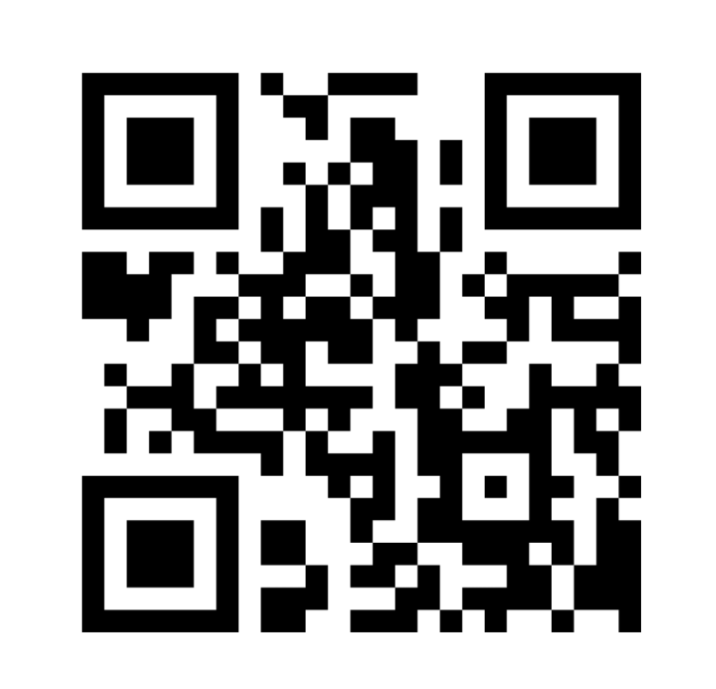
Two-factor Authentication:
Became a high priority requirement.
Can use a key or QR code to set up.
Authenticator app is used to randomly generate codes, ensuring secure entry.
Notes:
<number>

Slide 7
Course Creation and Upload Content
Course can only be created by teachers.
Procedures such as client-side validation in place, to ensure data user entered is accurate and valid.
A teacher can upload files using a file chooser, they can also change the file name.
Validation also used for file upload.
Notes:
<number>

Slide 8
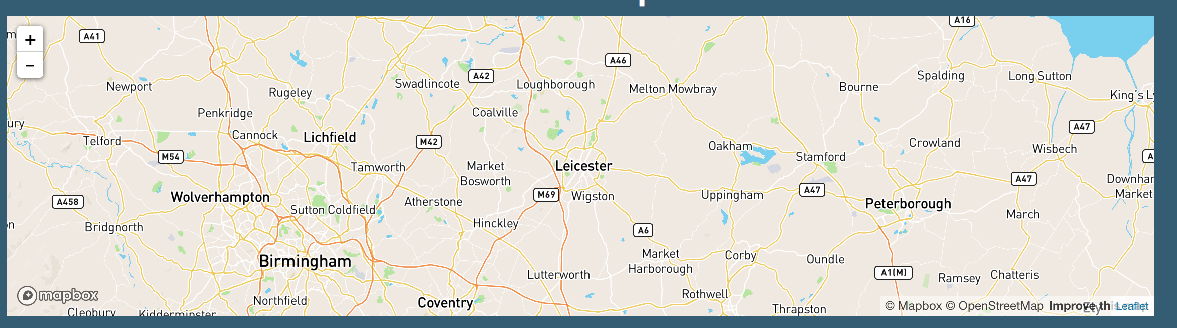
Map:
Set meetup point using embedded map.
Send invites to learners to make them aware of the meetup.
Notes:
<number>

Slide 9
Administrator Feature:
An admin account has privileges that are not available to learners or teachers.
Ability to disable/enable user accounts.
Monitor content such as reports and reviews.

Slide 10

Rate and Review Course:
Stars developed with learners in mind.
User can slide mouse across stars to select their rating on the various categories.
Can also leave a worded review to help other learners, decided if the course is right for them.
Notes:
With the review feature we thought about the user interface a lot. As we really wanted learners to have a pleasant experience when reviewing a course.
DEMO:
Implementing a star system, where a user can actually slide the stars using their mouse will not only make reviewing an enjoyable experience, but will provide a visual representation of what learners think about the course. I will now pass it over to Sean who will go talk you through the administrator role.
<number>

Slide 11
Learner Profile:
Can add friends who are on their course.
Badges area to assess how well themselves and other learners are doing.

Slide 12
Conclusion
Overall, we believe the project has gone very well.
If given more time more ‘should’ features could have been implemented.
Also, more accessibility features could have been added to broaden the websites target audience.

Slide 13
Priyan Mistry (pm322) – Manual Testing and various documentation.
Peiduo Chen (pc260) - Manual Testing and various documentation
Reece Wadsworth (rw235) – Front-end developer and manual testing.
Ronak Ranchor (rr199) – Front-end and back-end developer.
Sean Dewar (sdjd1) – Back-end developer and architect.
Michael Sakyiama (ms853) – Back-end developer and testing.
Marco Piazzi (mp526) - Back-end developer and testing.

